Slide 1
Graph NN
Abdul Samad
Adapted from Simon J.D. Prince

Slide 2
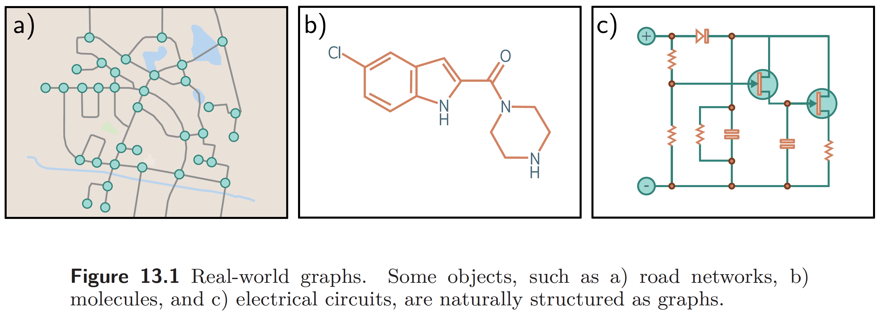
Graph Examples
Notes:
graph is a very general structure and consists of a set of nodes or vertices, where pairs of nodes are connected by edges or links.
For example, road networks can be considered graphs where the nodes are physical locations, and the edges represent roads between them (figure 13.1a). Chemical molecules are small graphs where the nodes represent atoms, and the edges represent chemical bonds (figure 13.1b). Electrical circuits are graphs where the nodes represent components and junctions, and the edges are electrical connections

Slide 3
More examples of Graphs
Some examples of graphs
• Social networks are graphs where nodes are people, and the edges represent friendships between them.
• The scientific literature can be viewed as a graph where the nodes are papers, and the edges represent citations.
• Wikipedia can be considered a graph where the nodes are articles, and the edges represent hyperlinks between articles.
• Protein interactions in a cell can be expressed as graphs, where the nodes are the proteins, and there is an edge between two proteins if they interact.

Slide 4
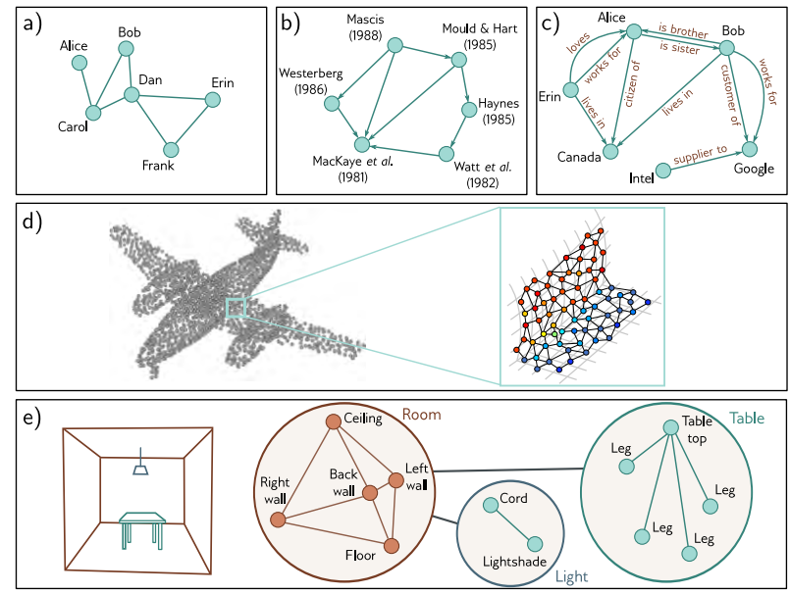
Types of Graphs
Notes:
The social network in figure 13.2a contains undirected edges; each pair of individuals with a connection between them have mutually agreed to be friends, so there is no sense that the relationship is directional.
In contrast, the citation network in figure 13.2b contains directed edges. Each paper cites other papers, and this relationship is inherently one-way.
Figure 13.2c depicts a knowledge graph that encodes a set of facts about objects by defining relations between them. Technically, this is a directed heterogeneous multigraph. It is heterogeneous because the nodes can represent different types of entities (e.g., people, countries, companies). It is a multigraph because there can be multiple edges of different types between any two nodes
The point set representing the airplane in figure 13.2d can be converted into a graph by connecting each point to its K nearest neighbors. The result is a geometric graph where each point is associated with a position in 3D space.
Figure 13.2e represents a hierarchical graph. The table, light, and room are each described by graphs representing the adjacency of their respective components. These three graphs are themselves nodes in another graph that represents the topology of the objects in a larger model

Slide 5
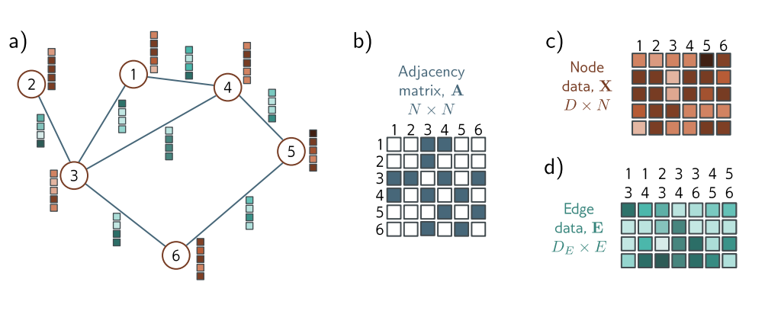
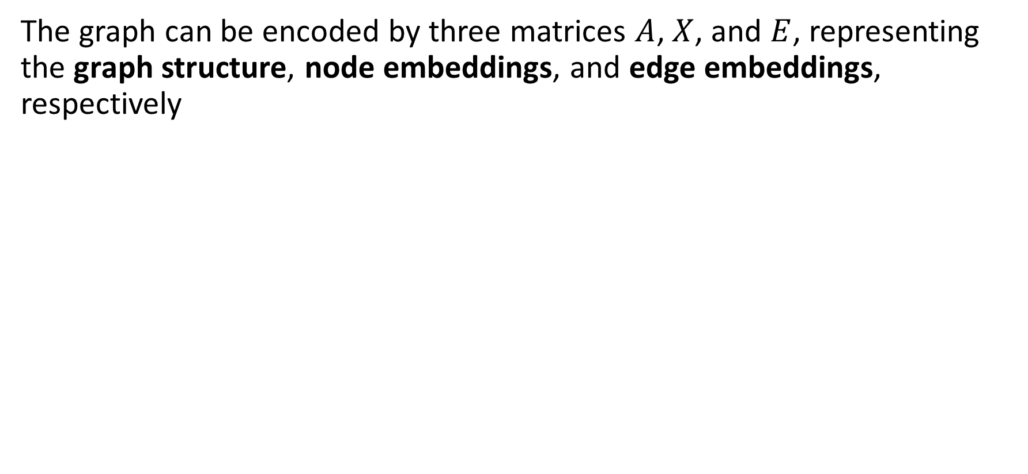
Graph Representation
The graph can be encoded by three matrices $A$, $X$, and $E$, representing the graph structure, node embeddings, and edge embeddings, respectively
Notes:
The graph structure is represented by the adjacency matrix, $A$. This is an $N × N$
matrix where entry $(m, n)$ is set to one if there is an edge between nodes $m$ and $n$ and zero otherwise. For undirected graphs, this matrix is always symmetric. For large sparse graphs, it can be stored as a list of connections $(m, n)$ to save memory.
The $nth$ node has an associated node embedding $x^{(n)}$ of length $D$. These embeddings
are concatenated and stored in the $D×N$ node data matrix $X$. Similarly, the $eth$ edge has an associated edge embedding $e^{e}$ of length $D_{E}$. These edge embeddings are collected into the $D_{E} × E$ matrix $E$.

Slide 6
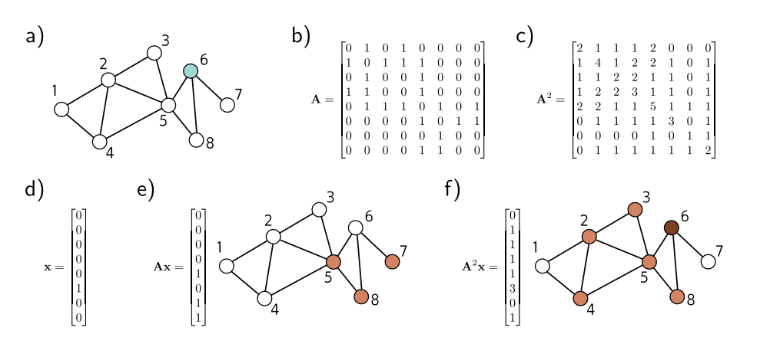
Properties of adjacency matrix
Notes:
Consider encoding the $nth$ node as a one-hot column vector (a vector with only one non-zero entry at position n, which is set to one)
When we pre-multiply this vector by the adjacency matrix, it extracts the $nth$ column of the adjacency matrix and returns a vector with ones at the positions of the neighbors (i.e., all the places we can reach in a walk of length one from the n th node).
If we repeat this procedure (i.e., pre-multiply by A again), the resulting vector contains the number of walks of length two from node n to every node

Slide 7
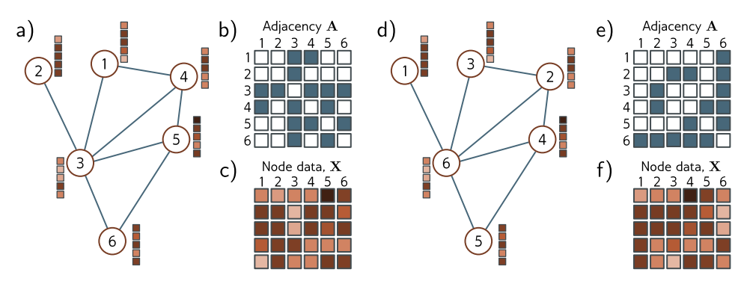
Permutation of node indices

Slide 8
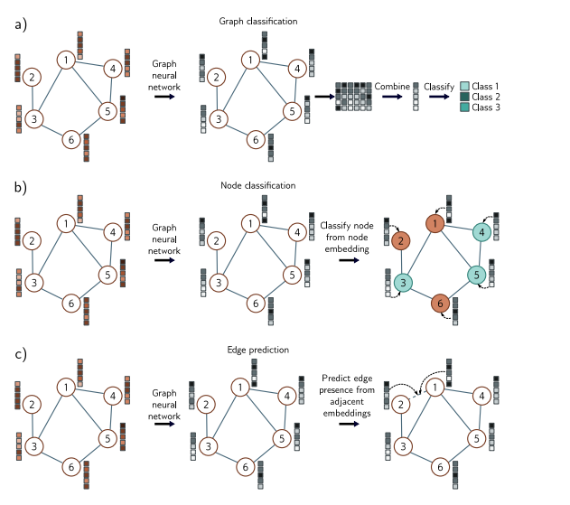
Tasks
Notes:
Common tasks for graphs. In each case, the input is a graph represented by its adjacency matrix and node embeddings. The graph neural network processes the node embeddings by passing them through a series of layers. The node embeddings at the last layer contain information about both the node and its context in the graph.
Graph classification. The node embeddings are combined (e.g., by averaging) and then mapped to a fixed-size vector that is passed through a softmax function to produce class probabilities.
Node classification. Each node embedding is used individually as the basis for classification (cyan and orange colors represent assigned node classes).
Edge prediction. Node embeddings adjacent to the edge are combined (e.g., by taking the dot product) to compute a single number that is mapped via a sigmoid function to produce a probability that a missing edge should be present.

Slide 9
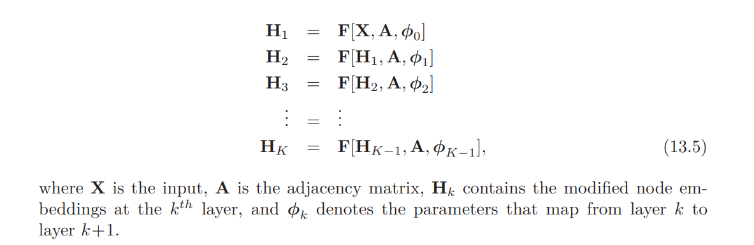
Graph Convolution NN
Notes:
These models are convolutional in that they update each node by aggregating information from nearby nodes
These induce a relational inductive bias (i.e., a bias toward prioritizing information from neighbors).
These are spatial-based because they use the original graph structure

Slide 10
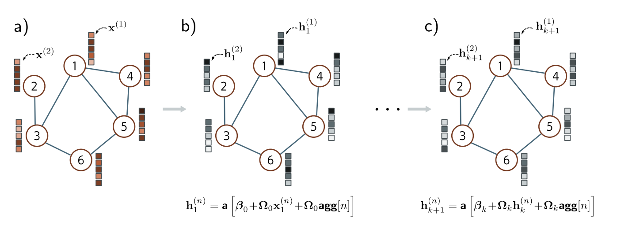
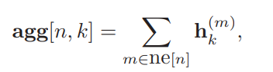
Example GCN
Notes:
At each node n in layer $k$, we aggregate information from neighboring nodes by summing their node embeddings $h$

Slide 11
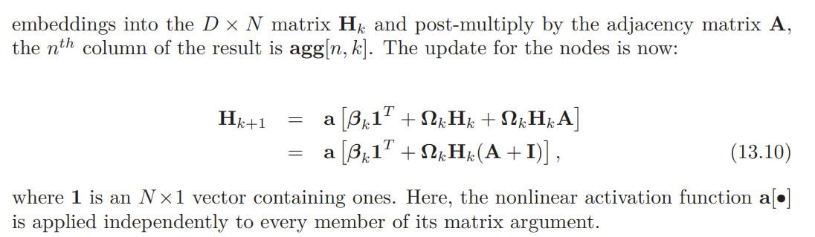
Example GCN

Slide 12
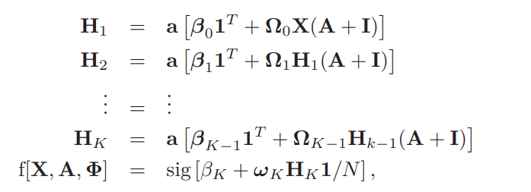
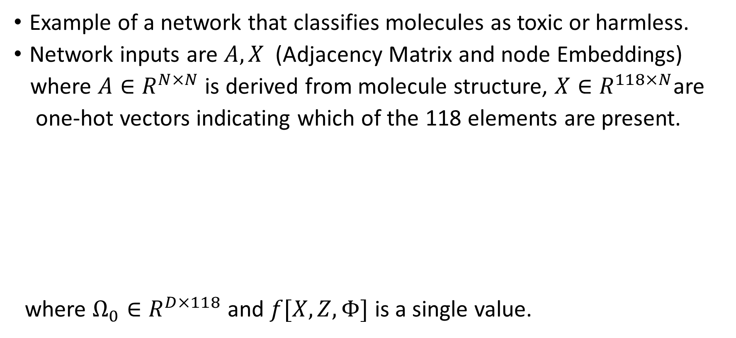
Graph classification
Example of a network that classifies molecules as toxic or harmless.
Network inputs are $A,X$ (Adjacency Matrix and node Embeddings)
where $A∈R^{N×N}$ is derived from molecule structure, $X∈R^{118×N}$are
one-hot vectors indicating which of the 118 elements are present.
where $Ω_{0}∈R^{D×118}$ and $f[X,Z,Φ]$ is a single value.

Slide 13
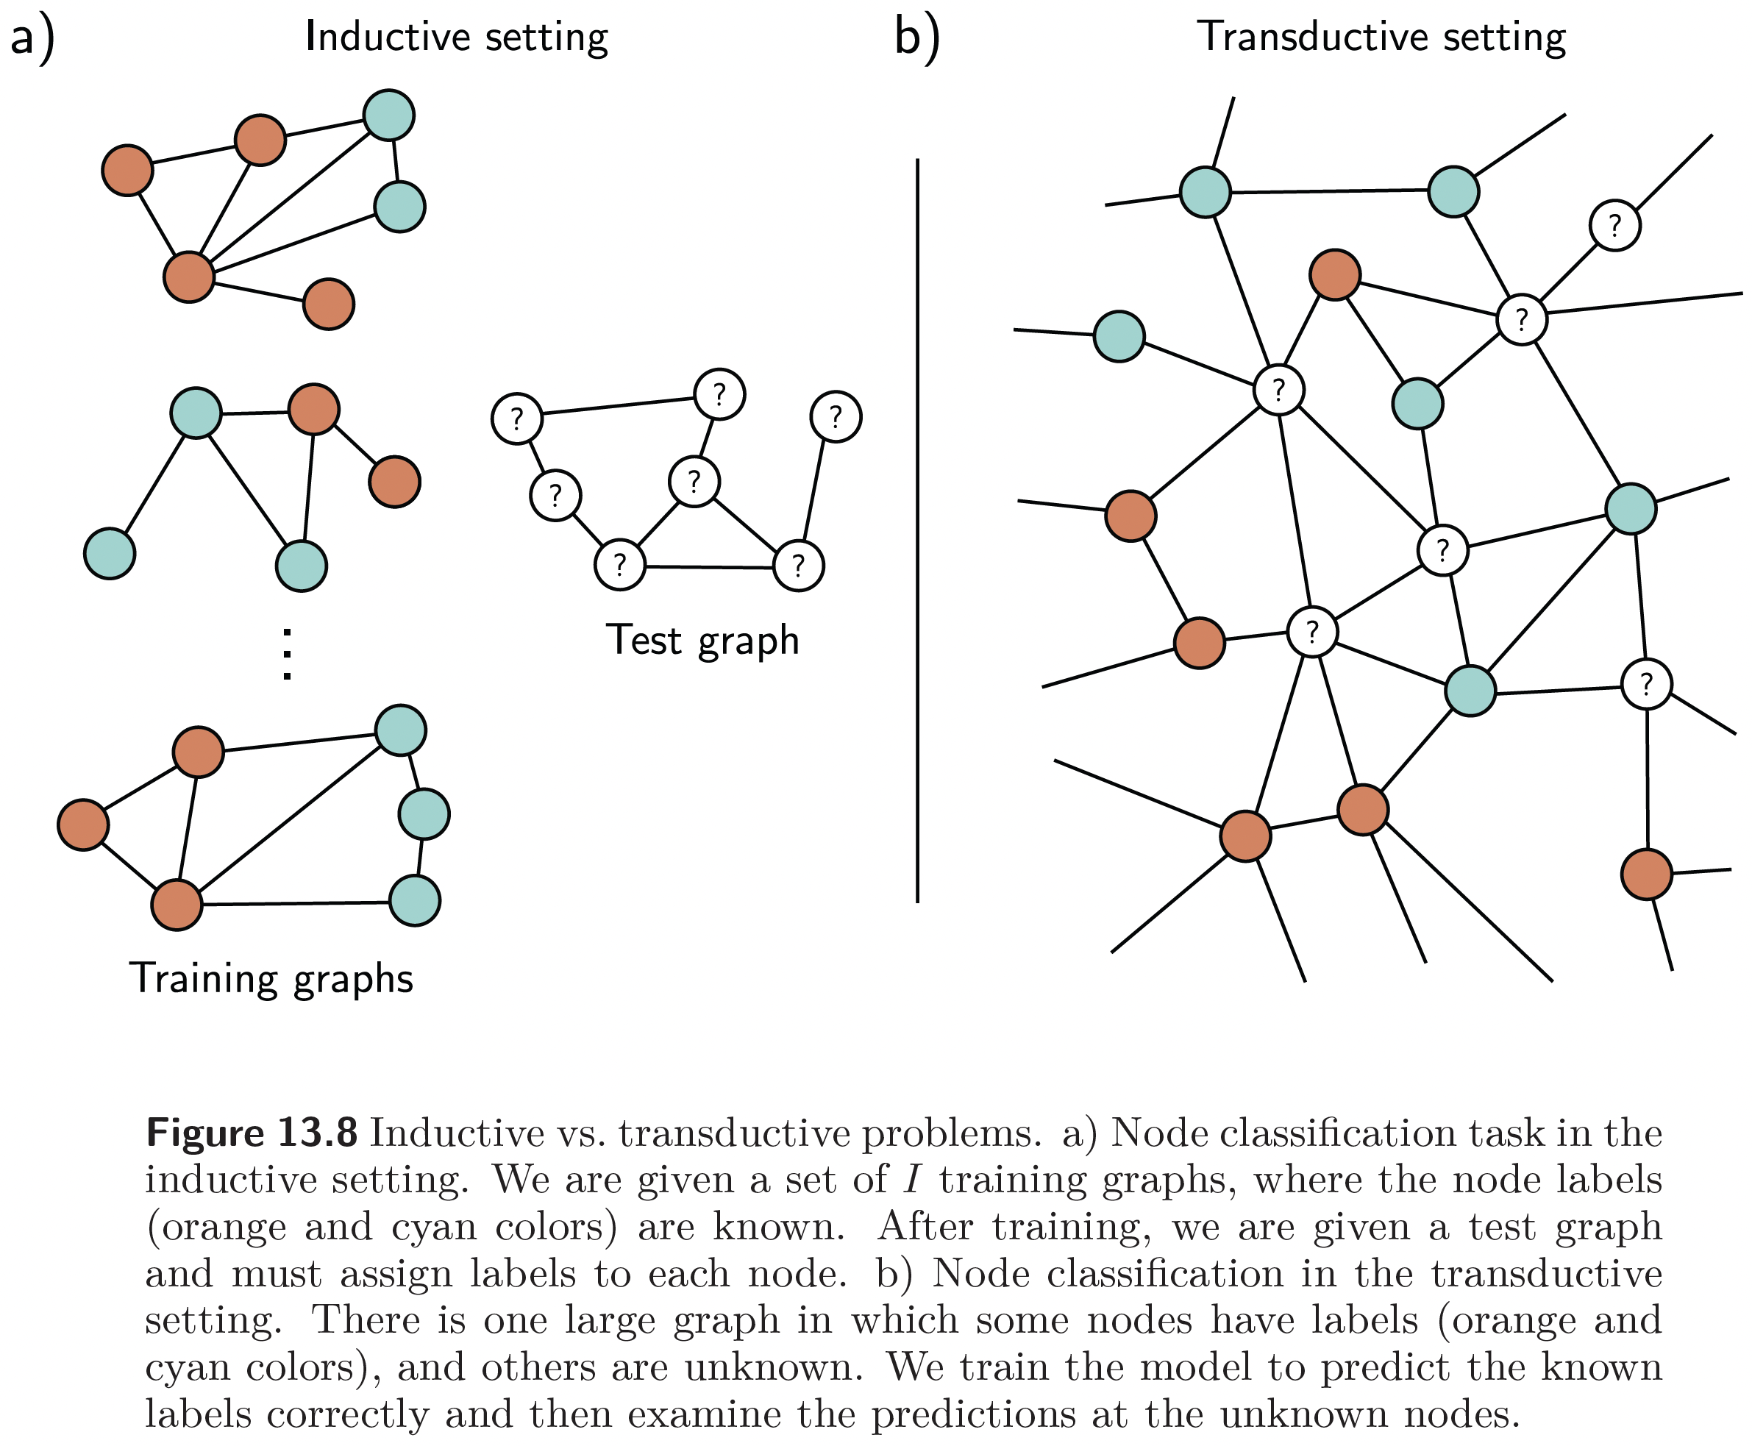
This work is subject to a Creative Commons CC-BY-NC-ND license. (C) MIT Press.

Slide 14
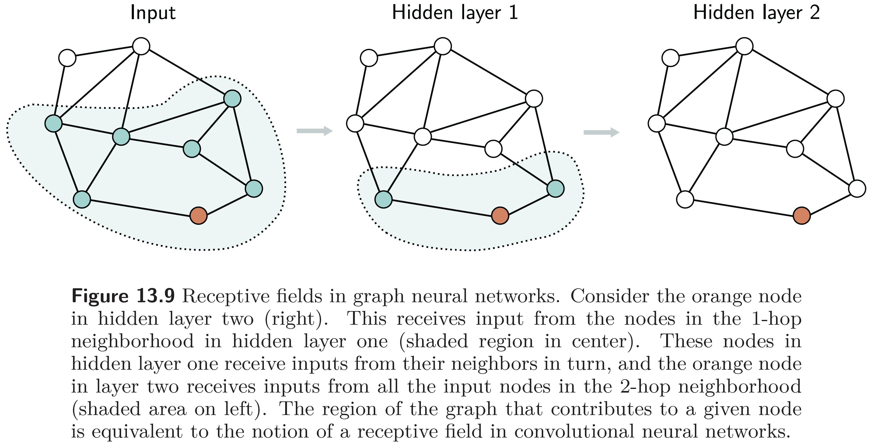
This work is subject to a Creative Commons CC-BY-NC-ND license. (C) MIT Press.

Slide 15
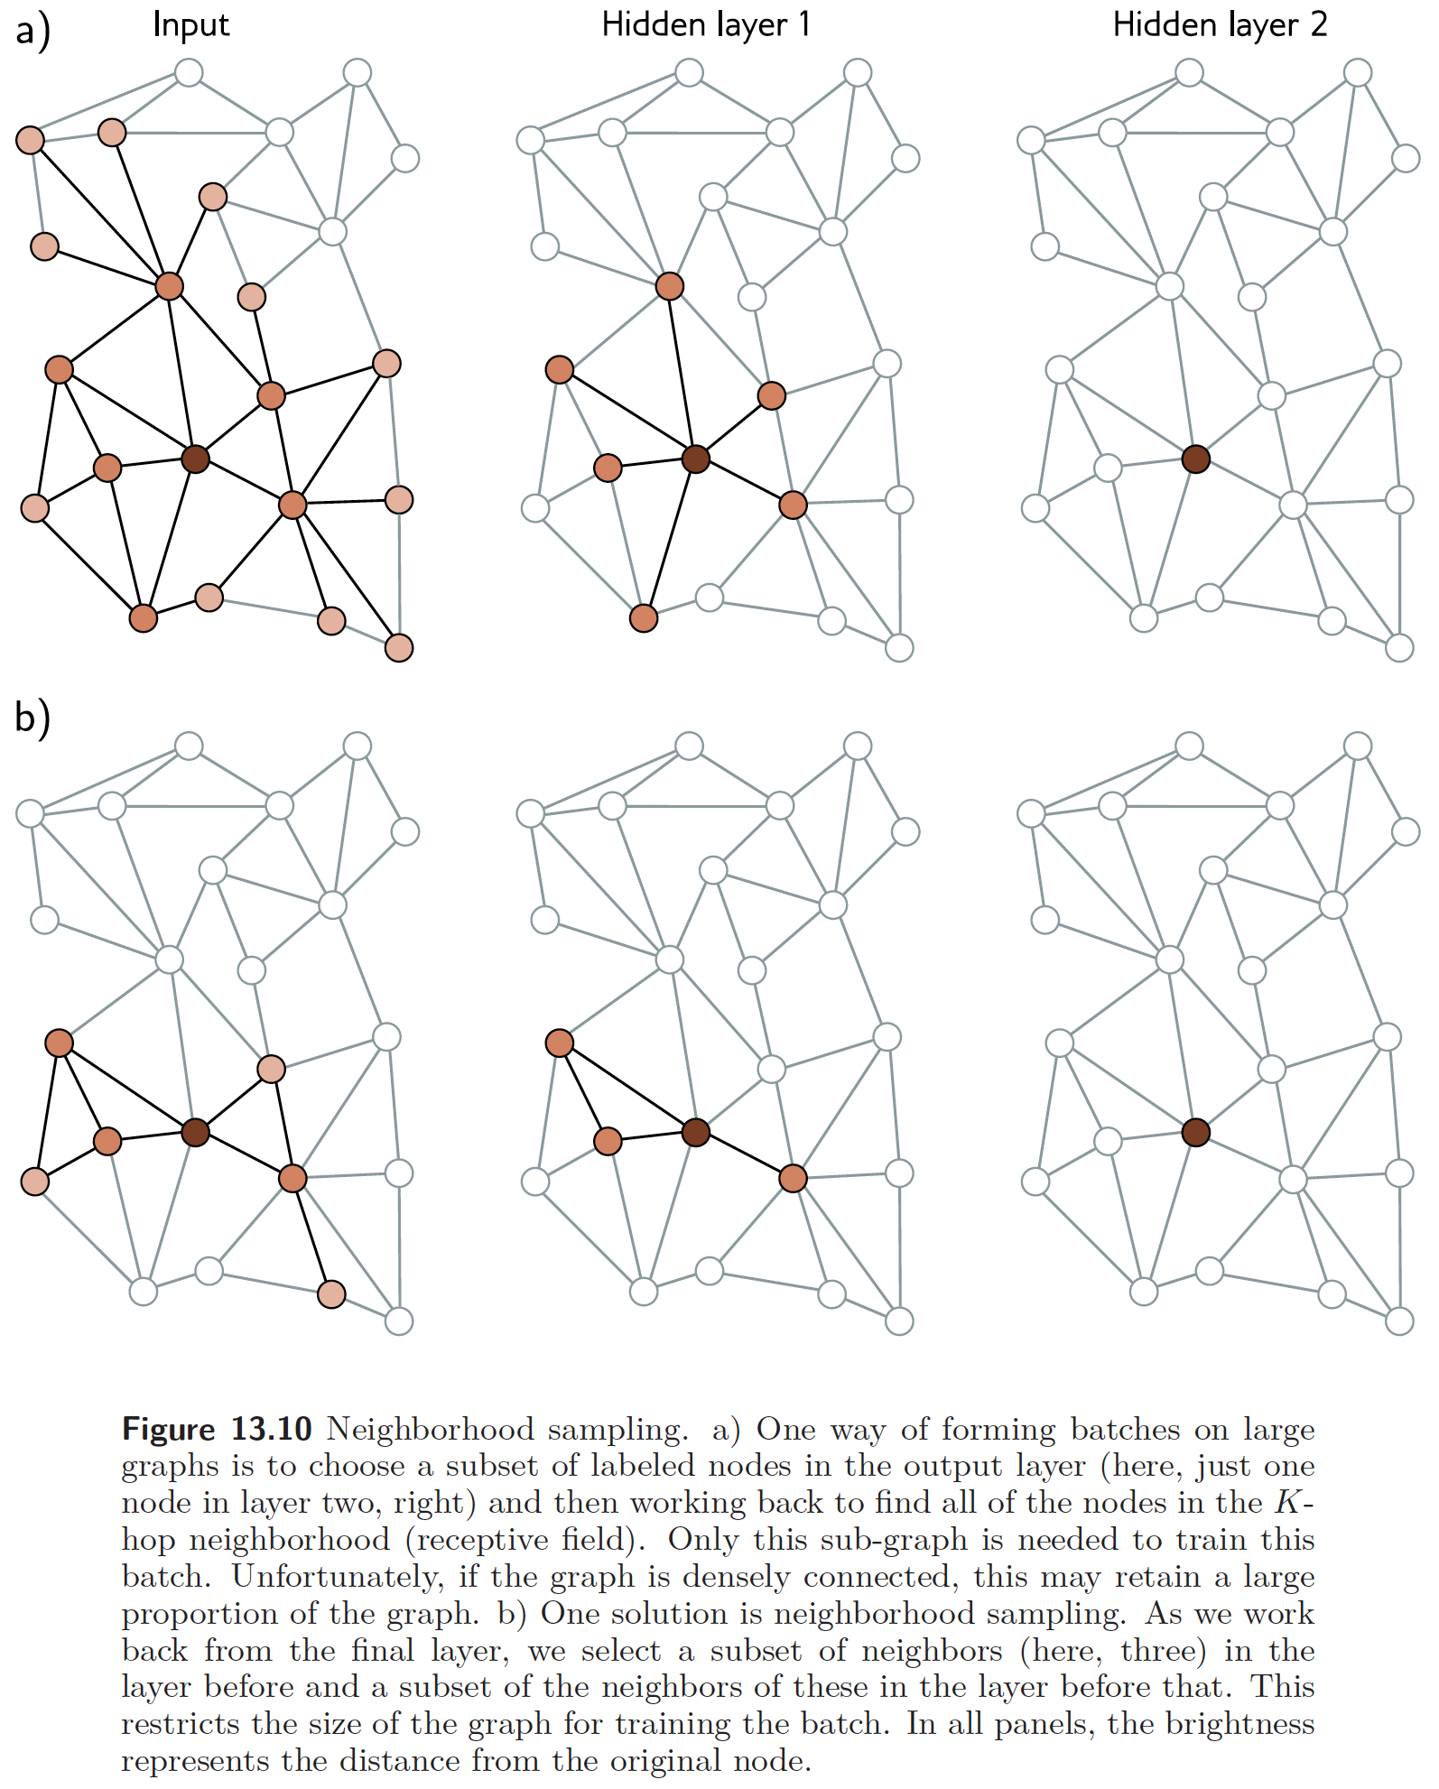
This work is subject to a Creative Commons CC-BY-NC-ND license. (C) MIT Press.

Slide 16
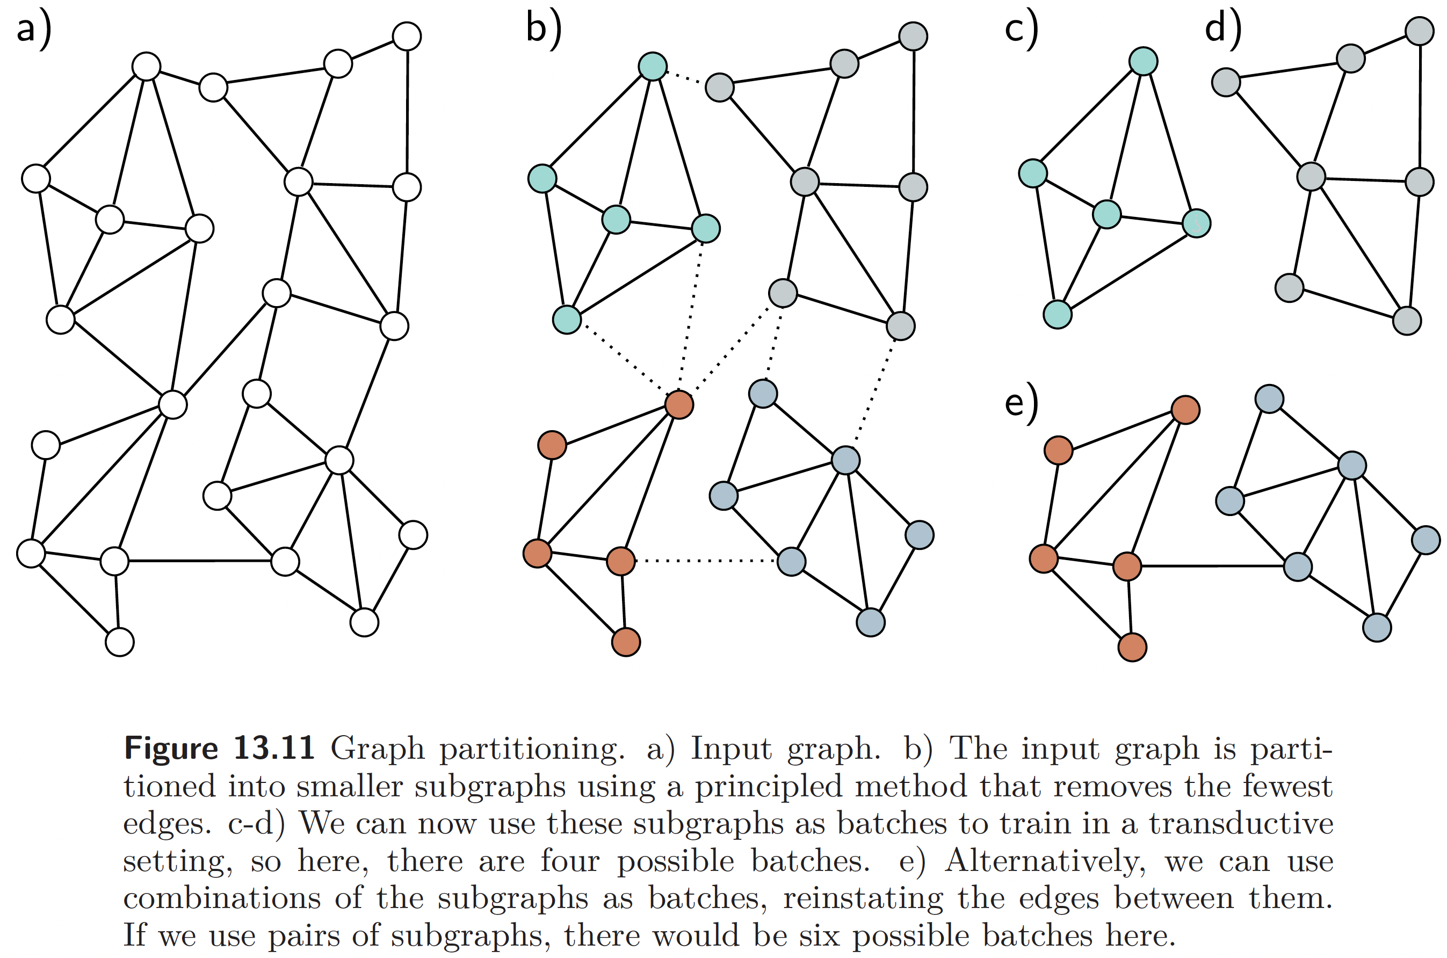
This work is subject to a Creative Commons CC-BY-NC-ND license. (C) MIT Press.

Slide 17
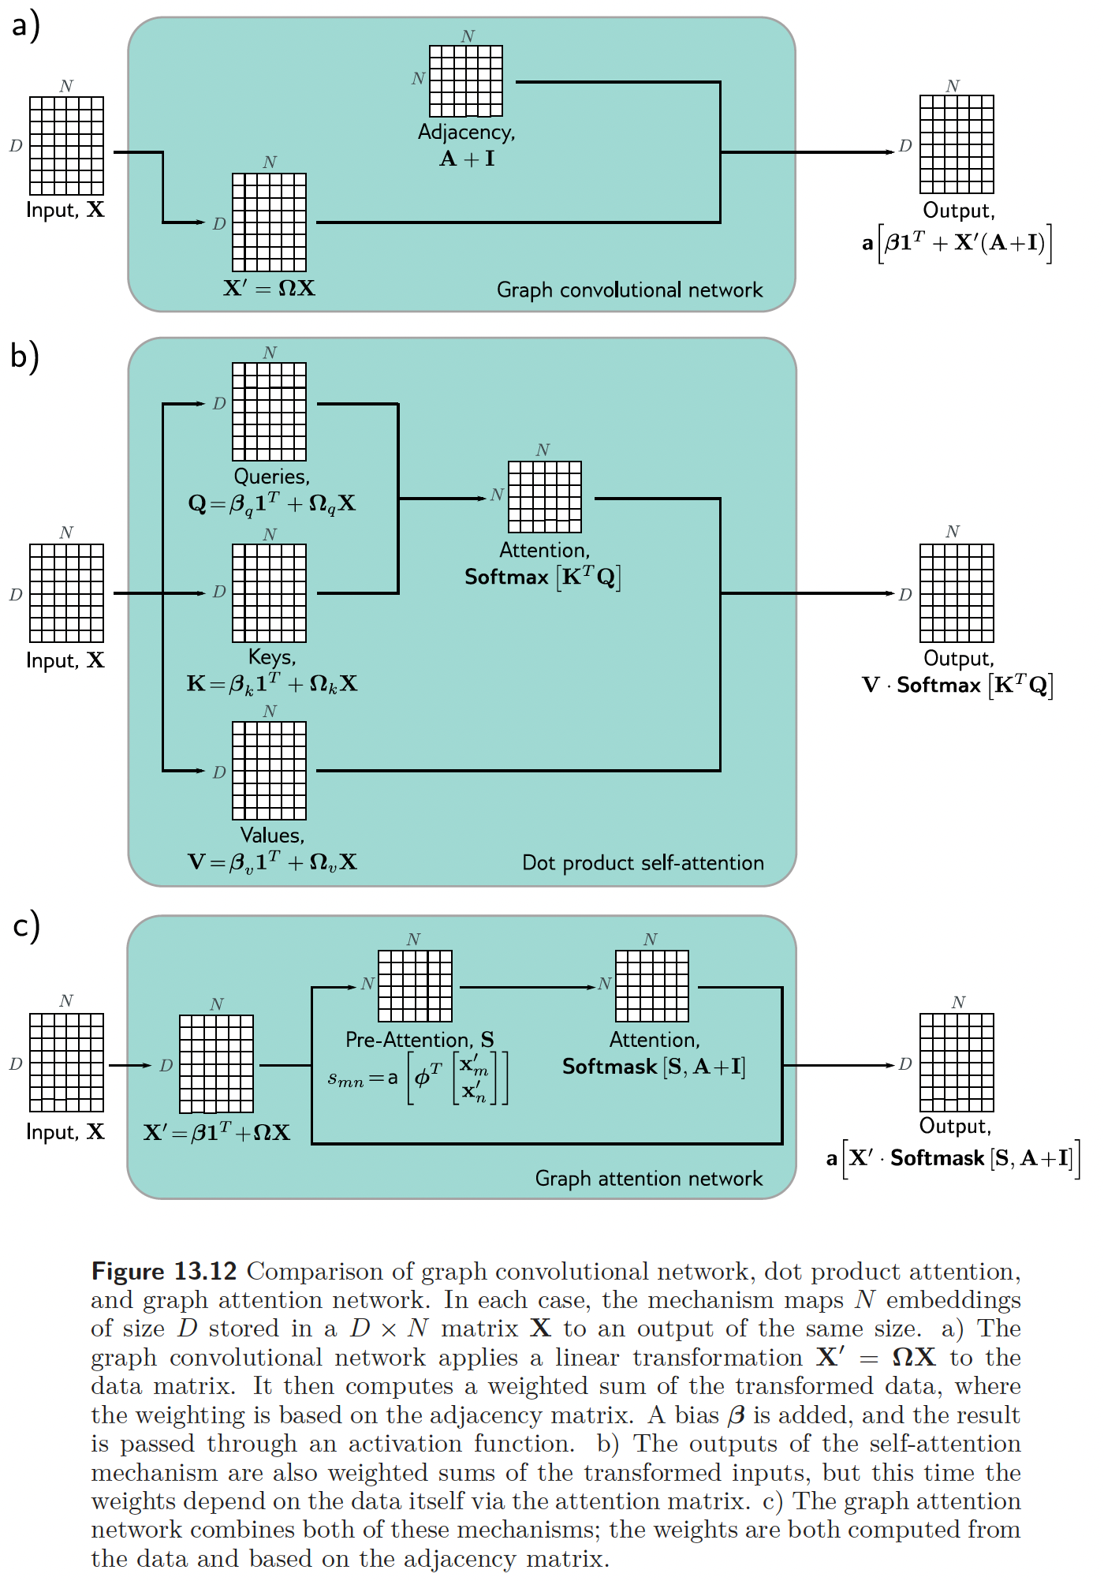
This work is subject to a Creative Commons CC-BY-NC-ND license. (C) MIT Press.

Slide 18
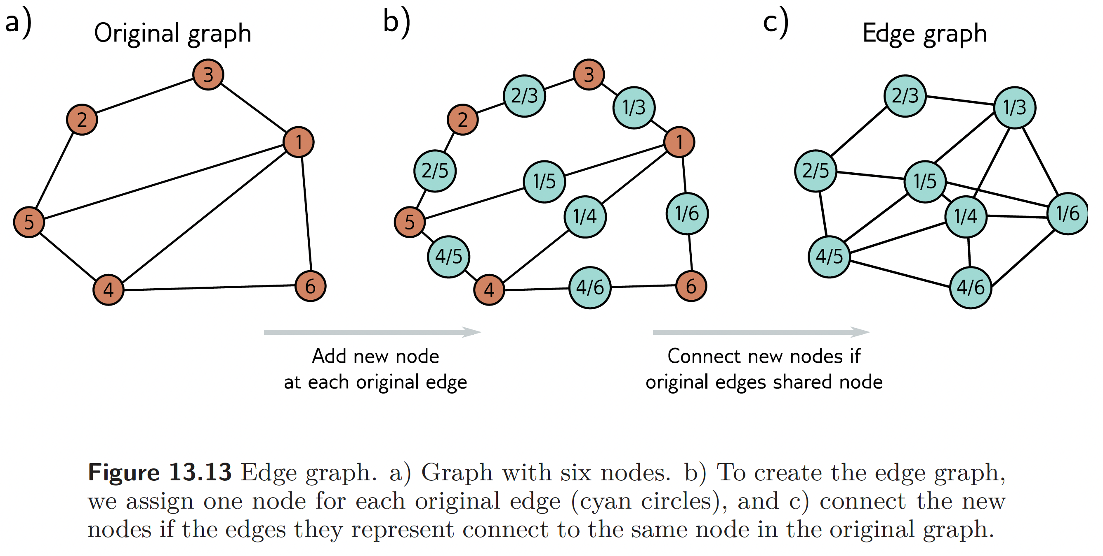
This work is subject to a Creative Commons CC-BY-NC-ND license. (C) MIT Press.

Slide 19
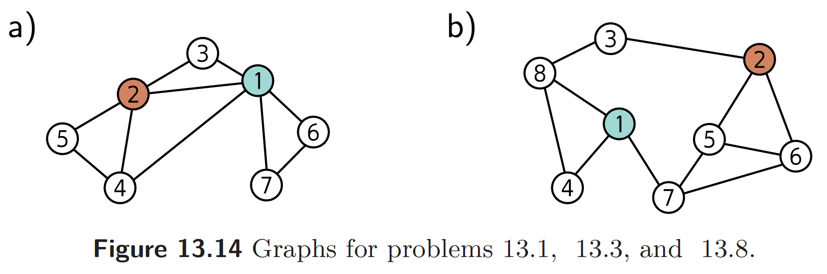
This work is subject to a Creative Commons CC-BY-NC-ND license. (C) MIT Press.

Slide 20
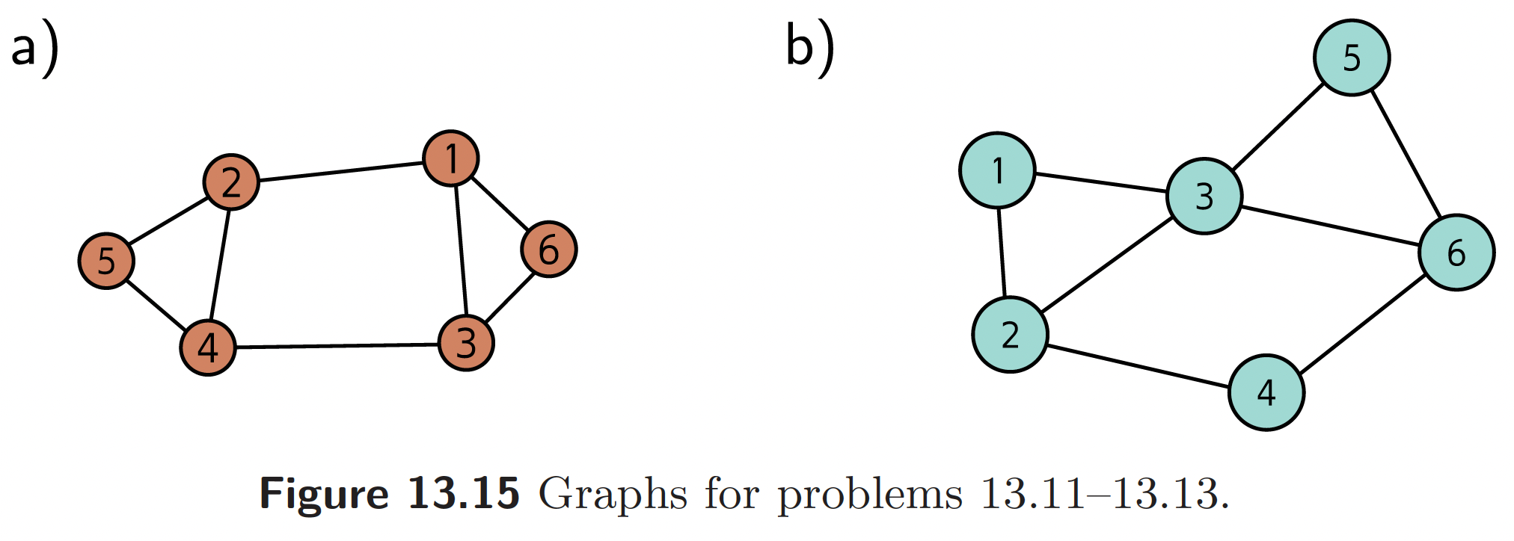
This work is subject to a Creative Commons CC-BY-NC-ND license. (C) MIT Press.

